Slide 1
Truth and Dare
Mobile Application Development

Slide 2


Agenda
2
A
z
Group Members:
Amina Nazir ACS221042
Ayesha Sana ACS221034
Zeeshan Ali ACS221056
Introduction
Code description
Summary

Slide 3
Introduction Ayesha sana
Our Truth or Dare app is not just a game; it's a catalyst for unforgettable moments and shared laughter. Add your personal touch to the questions and challenges, hit the start button, and let the virtual spin bottle dictate the next move. Whether you're hosting a party, a small gathering, or just hanging out with friends, our app guarantees a good time filled with surprises.

Slide 4
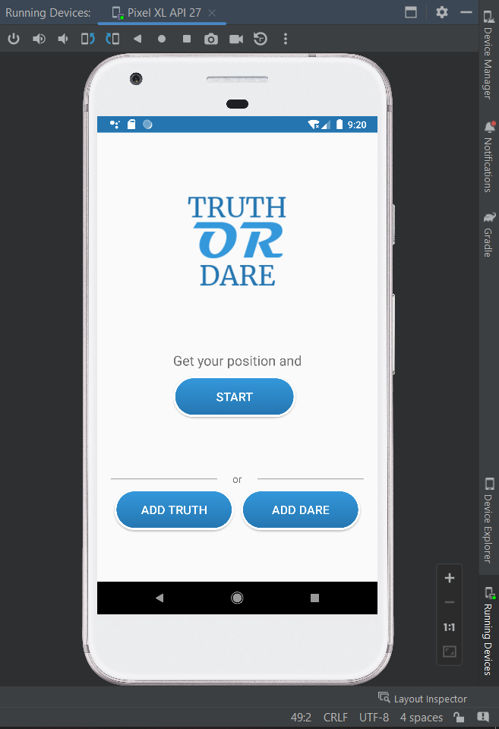
Start_Activity

Slide 5
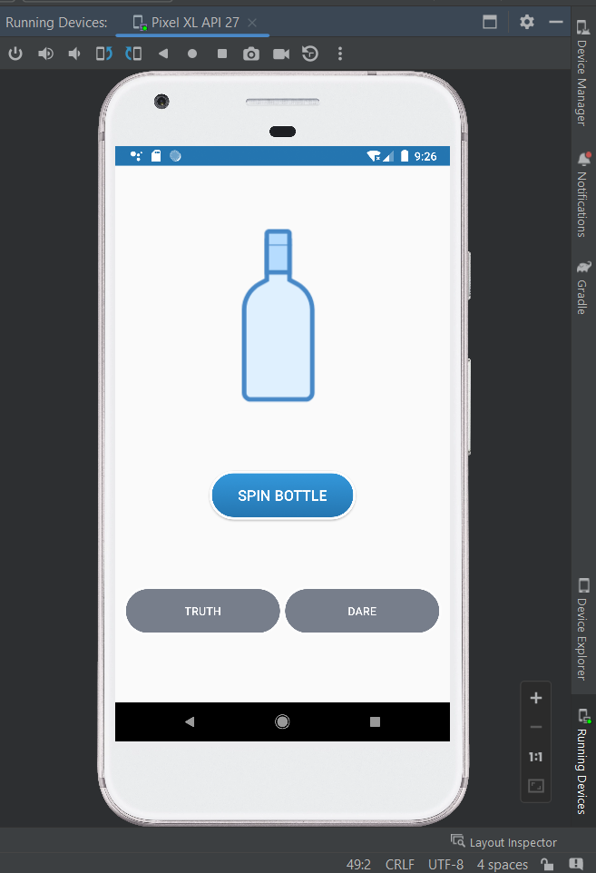
Main_Activity

Slide 6
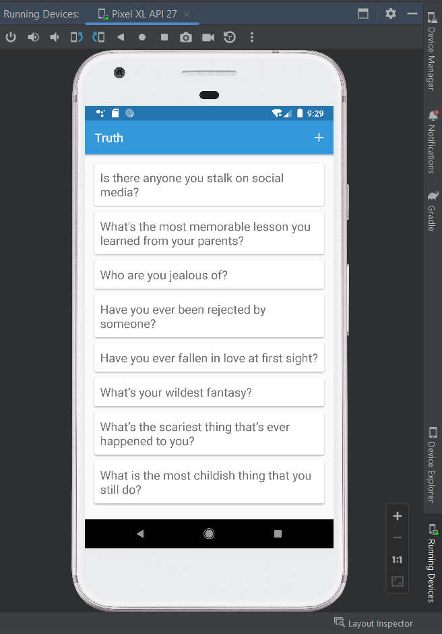
Truth_Activity

Slide 7
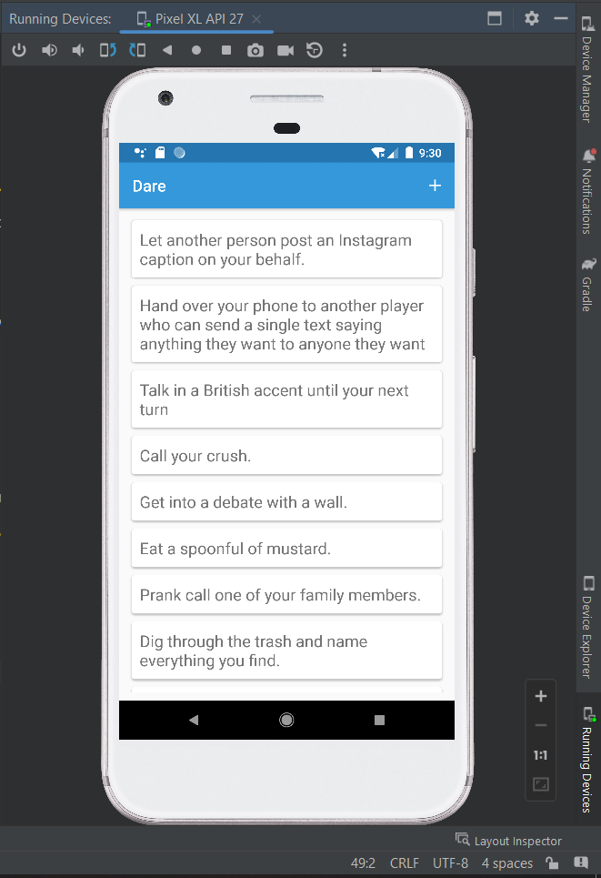
Dare_Activity

Slide 8
Code Description
Amina Nazir

Slide 9
Main_Activity.java
public void spin(View view) { int newDirection = random.nextInt(5400); float pivotX = imgView.getWidth()/2; float pivotY = imgView.getHeight()/2; Animation rotate = new RotateAnimation(lastDirection, newDirection, pivotX, pivotY); rotate.setDuration(2000); rotate.setFillAfter(true); rotate.setAnimationListener(new Animation.AnimationListener() { @Override public void onAnimationStart(Animation animation) { mp.start(); btn.setEnabled(false); } @Override public void onAnimationEnd(Animation animation) { mp.stop(); mp.release(); mp = null; truthBtn.setEnabled(true); dareBtn.setEnabled(true); } @Override public void onAnimationRepeat(Animation animation) { } }); lastDirection = newDirection; imgView.startAnimation(rotate); }
@Override protected void onCreate(Bundle savedInstanceState) { super.onCreate(savedInstanceState); setContentView(R.layout.activity_main); btn = findViewById(R.id.button); truthBtn = findViewById(R.id.btn1); dareBtn = findViewById(R.id.btn2); imgView = findViewById(R.id.imageView); truthBtn.setOnClickListener(new View.OnClickListener() { @Override public void onClick(View view) { startActivity(new Intent(getApplicationContext(), TruthActivity.class)); } }); dareBtn.setOnClickListener(new View.OnClickListener() { @Override public void onClick(View view) { startActivity(new Intent(getApplicationContext(), DareActivity.class)); } }); }

Slide 10
Start_Activity.java
@Override protected void onCreate(Bundle savedInstanceState) { super.onCreate(savedInstanceState); //setRequestedOrientation(ActivityInfo.SCREEN_ORIENTATION_PORTRAIT); setContentView(R.layout.activity_start); start = findViewById(R.id.start); truth = findViewById(R.id.truth); dare = findViewById(R.id.dare); start.setOnClickListener(new View.OnClickListener() { @Override public void onClick(View view) { startActivity(new Intent(getApplicationContext(), MainActivity.class)); } }); truth.setOnClickListener(new View.OnClickListener() { @Override public void onClick(View view) { startActivity(new Intent(getApplicationContext(), TruthActivity.class)); } }); dare.setOnClickListener(new View.OnClickListener() { @Override public void onClick(View view) { startActivity(new Intent(getApplicationContext(), DareActivity.class)); } }); }

Slide 11
Truth_Activity.java
@Override public void onClick(View view) { String mText = input.getText().toString(); if(mText.isEmpty()) Toast.makeText(getApplicationContext(), "Empty Text", Toast.LENGTH_LONG).show(); else{ updateUserData(mText); adapter.notifyDataSetChanged(); Toast.makeText(getApplicationContext(), "Successfully Added", Toast.LENGTH_SHORT).show(); } dialog.dismiss(); } });
public void updateUserData(String string) { ArrayList<String> textList = new ArrayList<>(); if(sharedPreferences.contains("UserTruths")) { String jsonTruths = sharedPreferences.getString("UserTruths", null); String[] truths = gson.fromJson(jsonTruths, String[].class); for(int i=0; i<truths.length; i++) textList.add(truths[i]); } textList.add(string); editor.putString("UserTruths", gson.toJson(textList)); editor.apply(); truthList.add(new TruthItem(string)); }

Slide 12
Values.java
public class Values { String[] truths = new String[]{ "Is there anyone you stalk on social media?", "What's the most memorable lesson you learned from your parents?", "Who are you jealous of?", "Have you ever been rejected by someone?", "Have you ever fallen in love at first sight?", "What’s your wildest fantasy?", "What’s the scariest thing that’s ever happened to you?", "What is the most childish thing that you still do?" }; String[] dares = new String[]{ "Let another person post an Instagram caption on your behalf.", "Hand over your phone to another player who can send a single text saying anything they want to anyone they want", "Talk in a British accent until your next turn", "Call your crush.", "Get into a debate with a wall.", "Eat a spoonful of mustard.", "Prank call one of your family members.", "Dig through the trash and name everything you find.", "Take a selfie with the toilet and post it online." }; }

Slide 13
SUMMARY
Zeeshan Ali

Slide 14
Any question ? If any so keep it to yourselves please !

Slide 15


Slide 16

Thank you

